Slide 1



NeCTAR eResearch Tools
Cloud-based Bioinformatics Tools Project
Steering Committee Meeting 15 July 2013

Slide 2
Agenda
Action Items from Previous Meeting
Project Report
Progress against milestones
Finance summary
Project Risks and Issues
External Dependencies
Other Business
Approach going forward

Slide 3
Action items from last meeting
Action Item | Status
Travis Endersby to begin blogging, will continue to blog significant milestones and progress | 4 blogs in past 3 months. This is adequate for now given the current readership. I have concluded new tools are necessary to get further reach. GOHaD will begin twitter and facebook communications also, which our group will contribute to regularly
Nigel suggested Travis Endersby provide an interim report to ensure project was back on the newly revised schedule upon the next due milestone. | Done.
Once project back on schedule, develop a timeline for broader user access to the tools. | Travis and the dev team took initiatives to get project back on schedule and has begun meetings with parties. Tegan McNab has undertaken survey’s on current LIMS usage.
Travis Endersby to scan and distribute the completed UAT documents to the Steering Committee members as they are signed off. | Done.

Slide 4
Project Report - Milestones
Funding Milestone 1 – Achieved and Payment received
Funding Milestone 2 – Achieved and payment received
Supported Tools and Processes;
Integration with the AAF authentication services;
Deployed in the AAF Test Environment
Have finally received permission to use UWA’s AAF Account to move this into Production at with no ongoing charges
Funding Milestone 3 (scheduled 31st August)
Integrated invoicing and billing module
Completed and Signed off
Initial Production Research Cloud Deployment
Code base has been approved in test environment
WARTN production data migrated to Production server and undergoing acceptance testing by SJOG staff. Intended to be complete for upcoming NeCTAR report.

Slide 5
Project Report - Milestones
Funding Milestone 4
A data extraction for analysis module;
100% Complete – signed off.
A pedigree (family) data management and visualisation module;
80% Complete – delayed while PhD student has 1 day a week availbility while writing. I have complete belief he will get this done but obviously at 1 day per week progress will be slow. Also have asked him to have some contiguous days to finish it off sooner.
In a pinch this could be finished off much sooner if I were to chip in, BUT doing this as part of his PhD is important for him AND the project as he has many “upgrades” or contributions to this project as part of his PhD.
Funding Milestone 5
Enhanced reporting functionality;
100% Complete – brought ahead of new schedule to balance for pedigree delay
Registry Management functionality
100% Complete (signed off individually now in addition to test cases in Initial Production Deploy sign off)
A Genotypic Data management module
20% complete
Have planned out and briefly started on a solution which avoids GVL
Will revisit GVL to see if suitability exists right now.

Slide 6
Project Report - Financial
Total project budget: $614,490
Total NeCTAR contribution: $289,000 (note revised down from initial request)
Total co-investment: $324,965
Funds received to-date $104,000
See attched NeCTAR financial report
A restructuring of funding milestones was made due to staffing and dependencies, we are awaiting the response, but all seems to be in order. For now we are reporting against existing milestones.

Slide 7
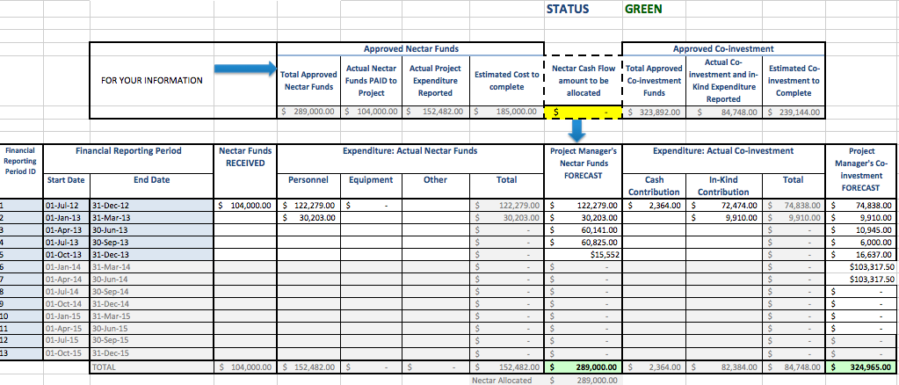
NeCTAR Financial Reporting

Slide 8
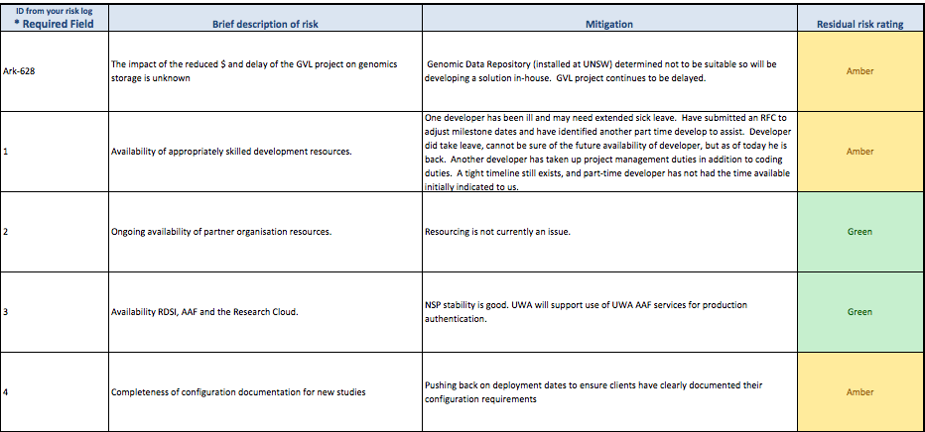
NeCTAR Reporting – Risks

Slide 9
Other Business
SPArk Grant under way to facilitate super computer analysis routines from within the ARK.
Date for next meeting – propose mid June, 2013.
Updaqte via email next report milestone
I have proposed some operational improvements going forward;

Slide 10
Approach Going Forward
Transparency – all projects and subcomponents will be estimated and tracked on Atlassian/JIRA.
All participants and committee members are welcome to view progress and make feature requests
All coders will be required to update these estimates each time they advance (or regress) in their goals/tasks
For those seeking a less proactive view, a manually produced summary email could be sent on some regular interval (monthly or fortnightly) if required.
Hopefully part of a fundamental philosophy/ethos: dealing with issues upfront and openly to get the best outcome

Slide 11
Approach Going Forward
Prioritization – this project is already at or beyond full capacity. Feature requests are welcomed via the JIRA system. However, everything will need to be prioritized.
If we keep a good track on priorities we don’t see opportunity cost of small superficial changes add up at the cost of larger key functionality missing deadlines.
Direct access to developers is not a recommended practice if we want priorities clear and time well managed.

Slide 12
Approach Going Forward
Knowledge Sharing and Documentation
We will try to ensure there is not one human point of failure for the system.
The system should be able to be managed by anyone with access to the documentation.
We are not there yet, but are putting these processes in place.
I also see a clear need to establish adequate User Documentation and training. Ideally we would like to try to establish a community of users also to share knowledge.

